Slide 1

Health Analysis Using Microsoft Power BI and python
PRATHMESH PATIL A-38
SAISHA PATIL A-39

Slide 2
Introduction
Health care analytics uses current and historical data to gain insights, macro and micro, and support decision-making at both the patient and business level.
The use of health data analytics allows for improvements to patient care, faster and more accurate diagnoses, preventive measures, more personalized treatment and more informed decision-making.
Health data is any data relating to the health of an individual patient or collective population.
With digital data collection, there is more and more health care data to be analyzed every second.

Slide 3
Thus in this project we are collecting medical data of the people residing in particular region and analyze their health depending upon various attributes.
Upon collecting the data, we will apply CART algorithm over the data and create a model which will predict the physical health of an individual.

Slide 4
Objective
The attributes of each person will be included in the data, including their age, gender, standard of living, level of fitness, brief medical history, location, etc.
The objective of the project is to use a machine learning algorithm over the collected data and predict the outcome. A decision tree would be shown as an output of the processed data. The processing would be done on the collected attributes such as region, age groups and overall health habits. This kind of processing is also called as prescriptive analysis.
In this project we are going to use the CART algorithm for the prediction. CART is a predictive algorithm used in machine learning and it explains how the target variable’s values can be predicted based on other matters.

Slide 5
Tools Used
Software Requirements :-
These are the software requirements for the project:
Tool used: Microsoft Power BI, Visual Studio Code, Jupyter Notebook
Operating system: Windows 11/10/8/7 64-bit operating system
Hardware Requirements :-
These are the minimum hardware requirements for the project:
Ram: 4 GB or higher.
Processor: 9th Gen Intel(R) Core(TM) i5-12400 2.50 GHz or higher.
HDD: 256 GB or higher.
Monitor: 1024 x 768 minimum screen resolution.

Slide 6
FLASK:
Flask is a popular web framework for building web applications using the Python programming language. It is designed to be lightweight and easy to use, allowing developers to quickly create web applications with minimal boilerplate code. Flask follows the Model-View-Controller (MVC) architectural pattern, although it is often considered a micro-framework because it does not require or enforce any particular project structure.

Slide 7
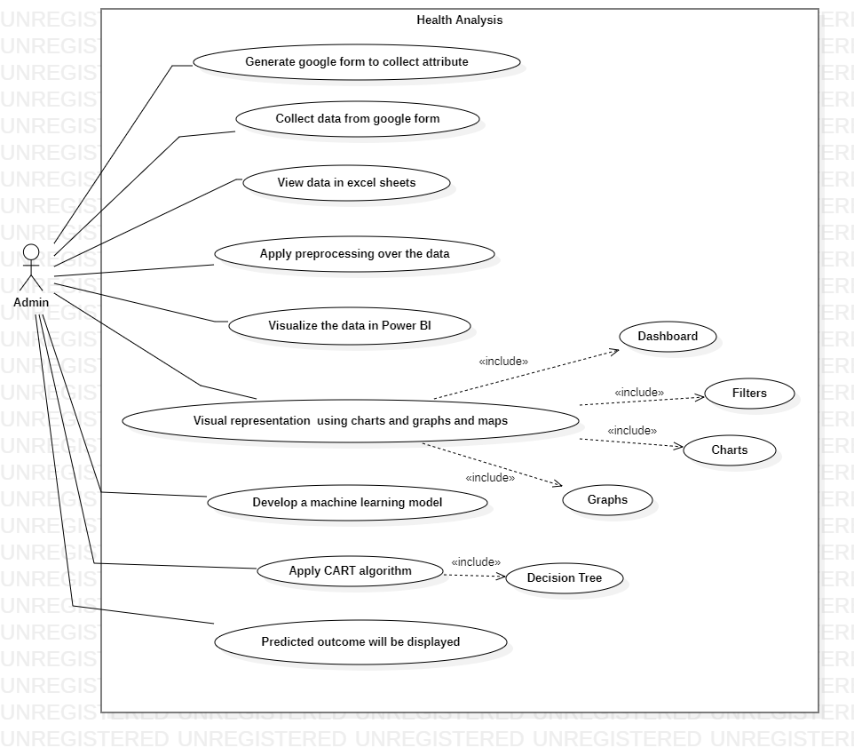
Use-Case Diagram

Slide 8
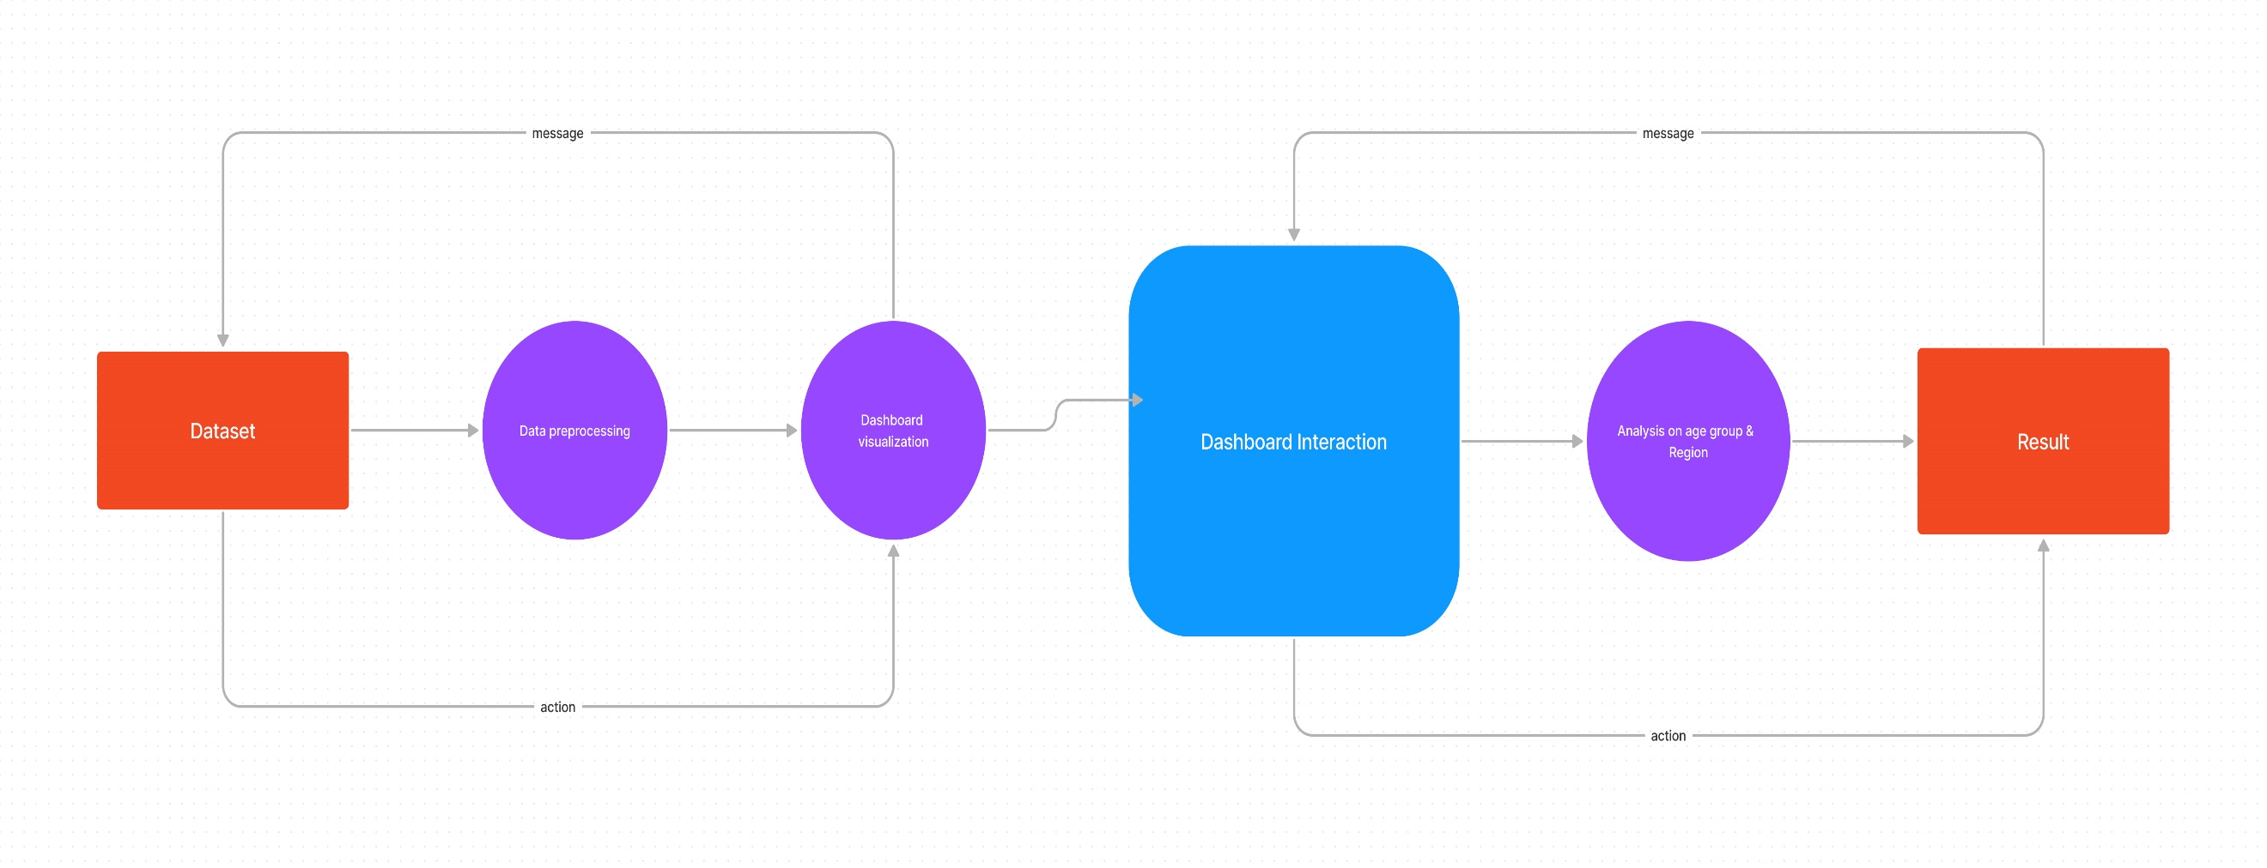
Data flow Diagram

Slide 9
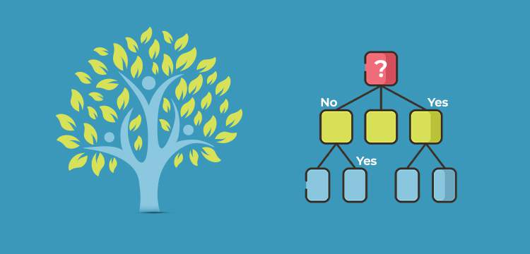
CART( Classification And Regression Tree) is a variation of the decision tree algorithm. It can handle both classification and regression tasks.
It is a decision tree where each fork is split into a predictor variable and each node has a prediction for the target variable at the end.
In the decision tree, nodes are split into sub-nodes on the basis of a threshold value of an attribute. The root node is taken as the training set and is split into two by considering the best attribute and threshold value. Further, the subsets are also split using the same logic. This continues till the last pure sub-set is found in the tree or the maximum number of leaves possible in that growing tree.

Slide 10
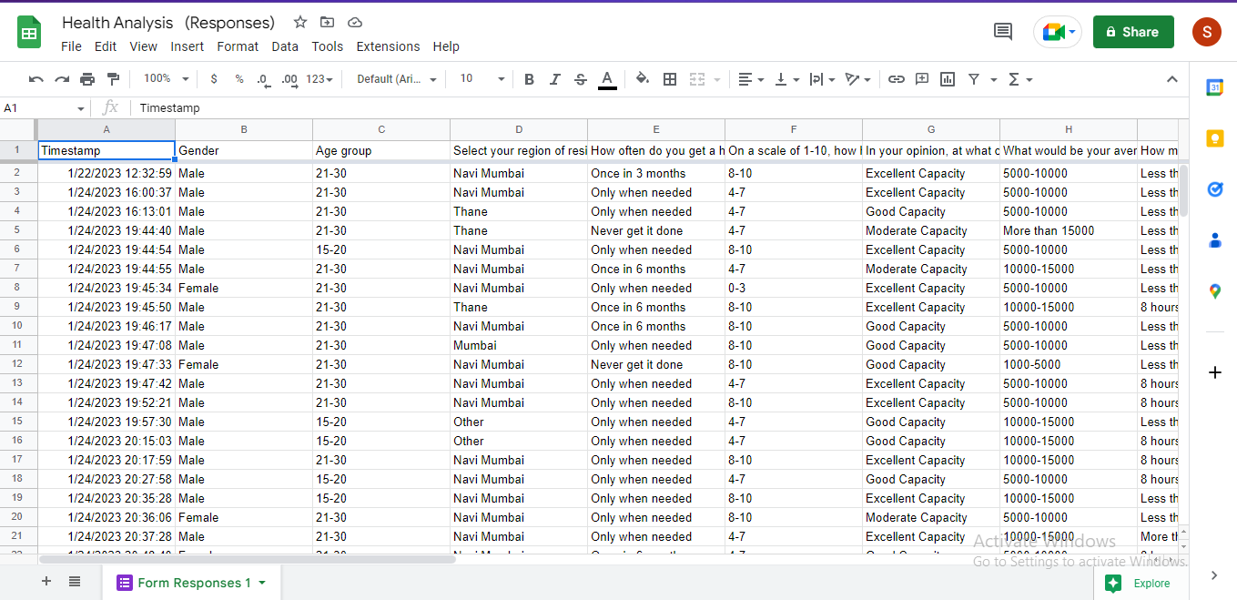
Screenshots

Slide 11
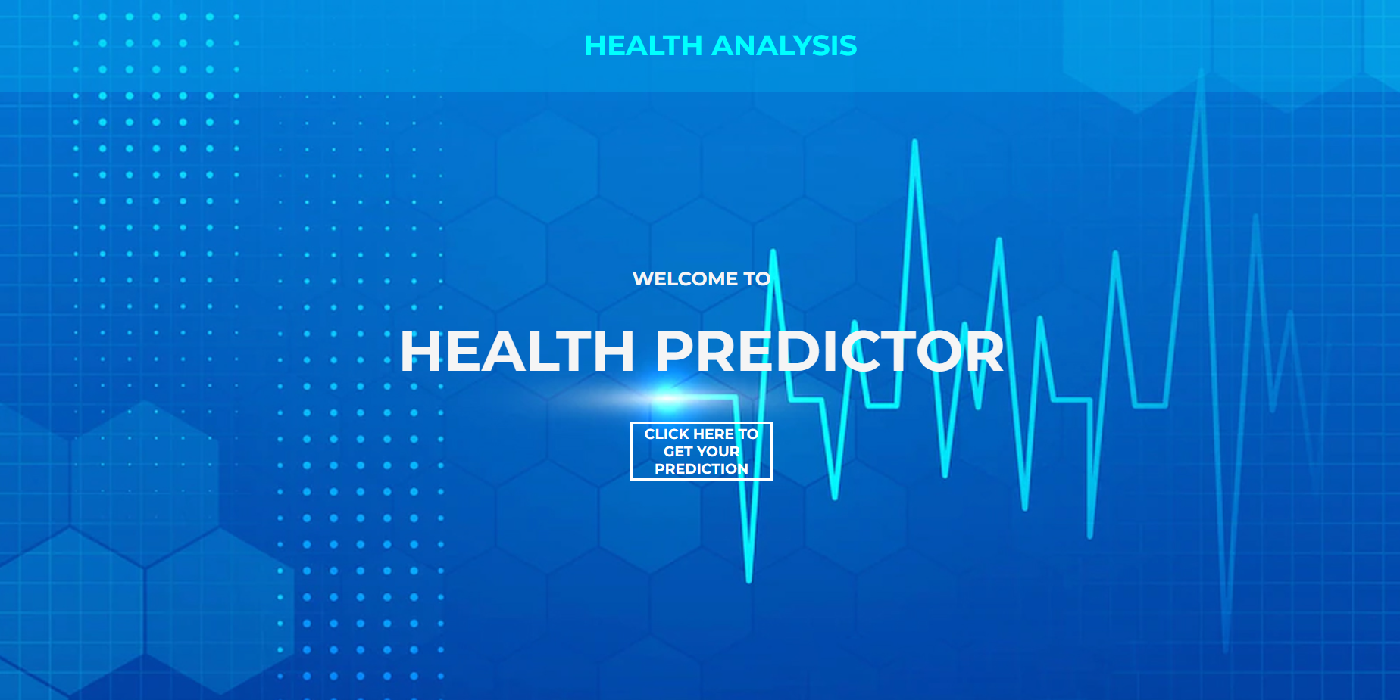

Slide 12
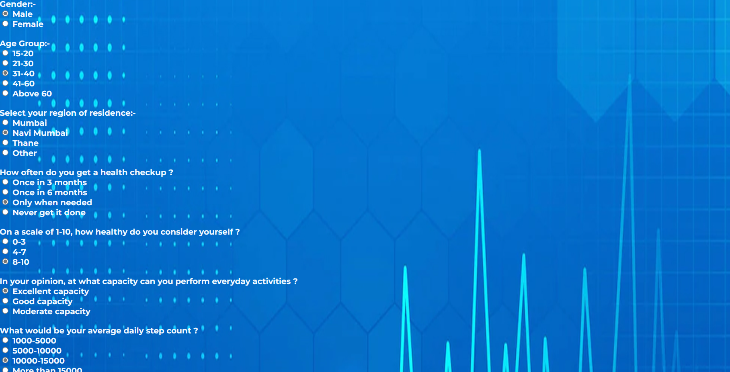

Slide 13
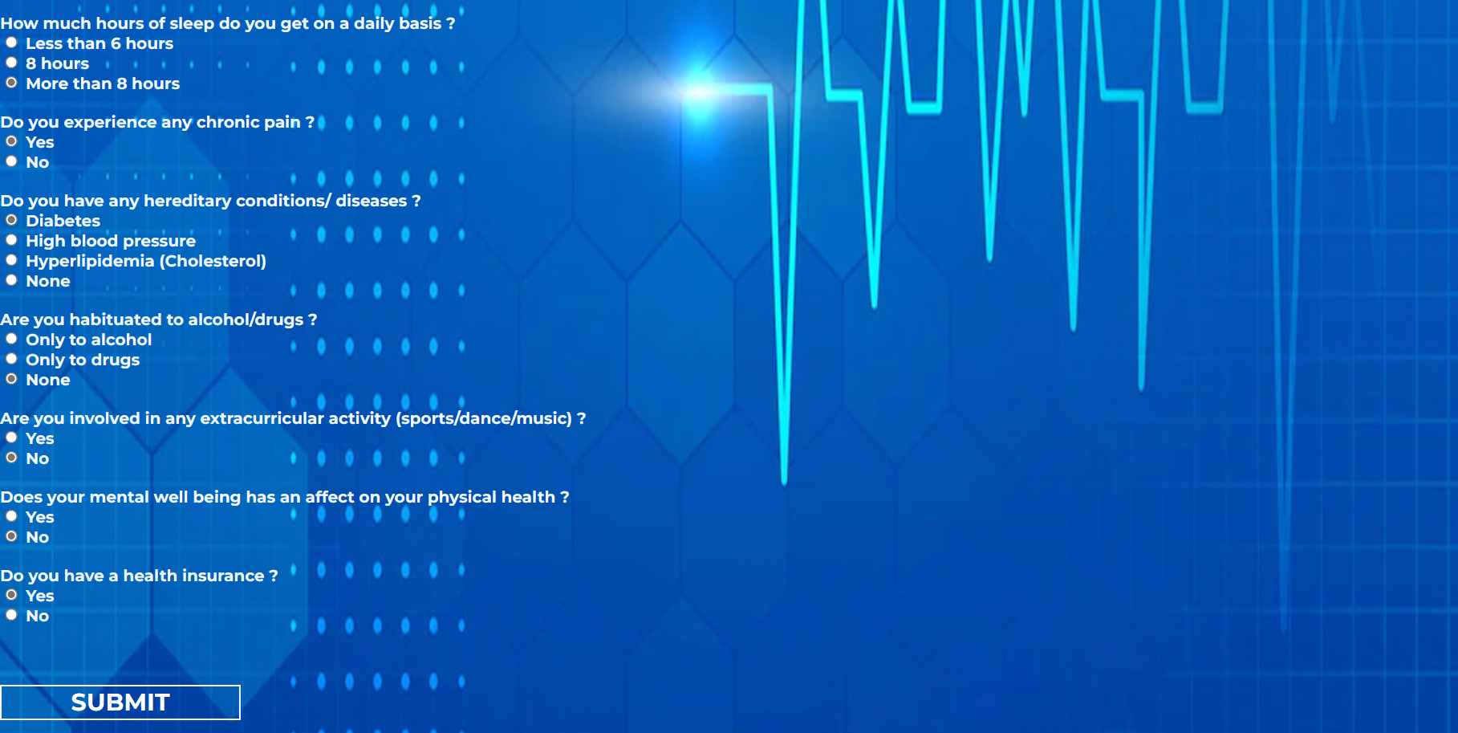

Slide 14
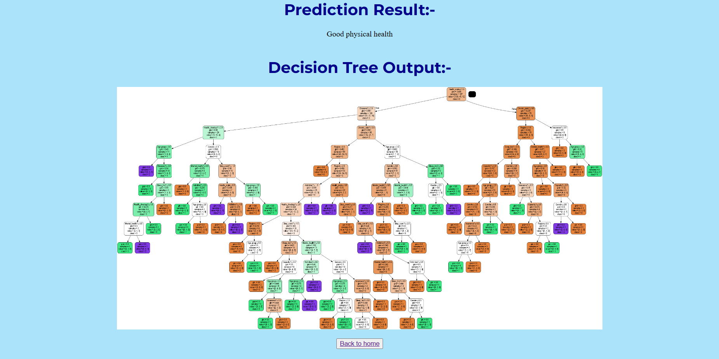

Slide 15
Thank you

